Slide 1
Software Testing Methodologies
Prashant Joshi

Slide 2
Module 1: Agenda
Module 1: Introduction to Software Testing & Techniques
Topic 1.1
Introduction to Software Testing
Topic 1.2
Overview of the Course
Topic 1.3
Software Testing Techniques
Topic 1.4
Software Testing – Quality Attributes, Types & Levels

Slide 3
Topic 1.1: Introduction to Software Testing

Slide 4
Software Testing Methodologies
Software Testing & Methodologies
What is your view?
What do you think it is all about?
What do you wish to learn?
Why do you want to learn?
Is it important? How important is it?
Why do you do it?
What does it tell you?
Is there a career in it?

Slide 5
A definition
Testing is a process of executing a program with the intent of finding errors

Slide 6
Why do we test?
Make a judgement about quality or acceptability
To discover Problems

Slide 7
What world are we talking of?
Messaging
Multimedia
Embedded Systems
Software
Space
Hardware
Networking
You Name it!
Security
Travel
Database
Learning
Telecommunications
Automobile
Analysis
Home
Medicine
Infotainment

Slide 8
What world are we talking of?
Messaging
Multimedia
Embedded Systems
Software is (nearly) everywhere. Thus we are talking about that “everything”.
Software
Space
Hardware
Networking
You Name it!
Security
Travel
Database
Learning
Telecommunications
Automobile
Analysis
Home
Medicine
Infotainment

Slide 9
Building Blocks
Architecture
Code
People
Process
Test
Test
Design
Specification
Product
Technology

Slide 10
Psychology of Test
Psychology of test
Attitude to break the system
Constructively destructive
How come it works!
The Medical Lab
Reports normal → Cannot detect the problem
A failure would trigger the way to treat
We do not hope for failure we work for failures not to occur

Slide 11
Product
Product Under Test
Software is not alone
Works with various systems
Various systems work with each other
Most vital
System must work right, always!
Available, always!

Slide 12
Process
Steps to success
Increase probability of success
Bring generality and consistency
Measure: What you cannot measure you cannot control!
Continuously improve
Even making tea is a process; To make good tea requires good process

Slide 13
Technology
Something all of us look for and wish to excel
Software Testing is a highly technical activity

Slide 14

Depth of STM
Lets look at the depth of the subject
Lets explore
Lets look at the facets

Slide 15


Views of STM

Slide 16
Software Engineering
IEEE Definition
Software Engineering: (1) The application of a systematic, disciplined, quantifiable approach to the development, operation and maintenance of Software; that is the application of engineering to software (2) The study of approaches as in (1).
Software Engineering is the establishment and use of a sound engineering principle in order to obtain economically software that is reliable and works efficiently on real machine. [Fritz Bauer]
Where did Software Engineering come from?
Rather why was there a thought of Software Engineering?

Slide 17
Software Engineering
Software Engineering came in the 60s; with attempts to develop large software systems various problems occurred
Cost Overruns
Late delivery
Lack of reliability
Inefficient Systems
Performance problems
Lack of usability
The aim was to overcome the above issues and much more…

Slide 18
Goals of Software Engineering
To improve quality of software
To improve the productivity of developers and software teams
And many more…
Our focus is on 1 as a part of our course

Slide 19
Software Quality Attributes
Reliability
Efficiency
Speed
Resource management
Usability
User friendliness
Intuitive
Maintainability: Should be easy to maintain
Scalability: Should scale as per the requirements of the user
Portability: Should work on various platforms/systems/hardware
Security: Should be secure from attacks
Testability: Should be testable

Slide 20
Software Quality Attributes
What is important to User?
What is important to the Engineers?
What is important for Mission Critical System and a Word Processor?
Compare say Space Shuttle software and a Text Editor

Slide 21
Software Testing Methodologies
Prashant Joshi

Slide 22
Topic 1.2: Overview of the Course

Slide 23
Learning Principles
Make everything as simple as possible, but not simpler
- Albert Einstein
I hear and I forget, I see and I remember, I do and I understand
- Confucius
“… You can know the name of a bird in all the languages of the world, but when you’re finished, you’ll know absolutely nothing whatever about the bird. You’ll only know about humans in different places, and what they call the bird, So let’s look at the bird and see what it’s doing – that’s what counts”
Richard P Feynman (Book: What Do You Care What Other People Think)

Slide 24
Building Blocks – A View
SW Products
SW Test Tools
Test Research
Test Techniques Application
Functional, Behavioral, IOT, Usability, Integration, Unit, Performance, Stress
Test Techniques Development
EC, BVA, DT, CEG, McCabe, OATS, Data Flow, Control Flow
Math
Set theory
Discrete
Combinatorial
Concepts
SW Arch, Design, Data Structures
Problem
Code coverage
Quality
Zero Defects

Slide 25
Ask the Questions!
What
When
Where
Which
Why
How

Slide 26
Our Course Structure
Modules
Course is divided into Modules
Topics
Each module is divided into Topics
Self Study & Quick Review
Every Module has Self Study & a Quick Review
Topic x.1
Module x
Topic x.2
Topic x.3

Slide 27
Modules
Module No | Module Title | Objectives
1 | Introduction to Software Testing & Techniques | Introduce the course and course handout. Bring a perspective of need and motivation for this course. Provide an overview of the course, quality attributes, levels and types of Testing
2 | Mathematics and Formal Methods | Provide a base to the software testing techniques in form of mathematics and formal methods. Review topics of permutation/combination, discrete mathematics and graph theory. Focus is on the relevance to software testing.
3 | Specification Based Testing | Bring an approach to look at the system from specification perspective. Learn the relevant techniques for testing specifications – Equivalence Class, Boundary Value Analysis, Combinatorial, Decision Tables and Domain Testing
4 | Code Based Testing | Take a code level approach to testing and assuring quality. Learn the relevant techniques for testing code – Path Based Testing and Data Flow Testing
5 | Model Based Testing | Introduce Model Based Testing. Various Model for Software testing, their choice and techniques. Learn Finite State Machine, Petri Nets and State Charts. Learn to use these to derive testing cases

Slide 28
Modules
Module No | Module Title | Objectives
6 | Object Oriented Testing | Understand the issues in OO Software Testing. Learn techniques and sublets of Unit, Integration and Systems Testing of OO Software. GUI Testing for OO Software
7 | Integration & System Testing | Overview and need for Integration and Systems Testing of Software. Learn the techniques of Integration and Systems Testing
8 | Life-Cycle Based Testing | Provide an overview from a life-cycle perspective of Software and Software Products. Agile Testing and Agile Model-Driven Development. Role of Test engineers in life-cycle-based testing
9 | Test Adequacy & Enhancement | Learn the need for test adequacy and need for enhancement of test cases. Various techniques and criteria for measuring of test adequacy (data and control flow). Using the criteria to enhance test cases.
10 | Test Case Minimization, Prioritization and Optimization | Explore and understand the need for minimization and prioritization. Review the regression test problem. Selection of test cases for regression.

Slide 29
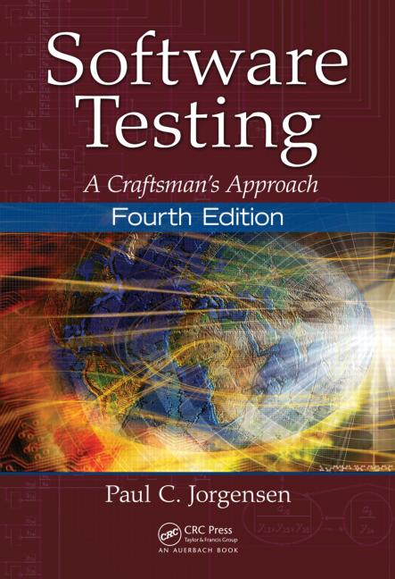
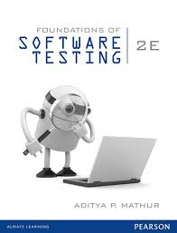
Text Books
T1 | Software Testing – A Craftsman’s Approach, Fourth Edition, Paul C Jorgenson, CRC Press
T2 | Foundations of Software Testing, Second Edition, Aditya P Mathur, Pearson

Slide 30
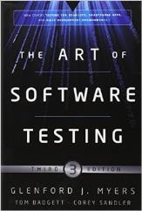
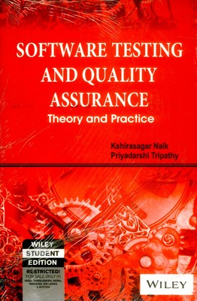
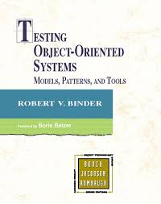
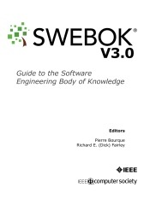
References
R1 | The Art of Software Testing, Third Edition, Glenford J. Myers, Tom Badget, Corey Sandler,
R2 | Software Testing and Quality Assurance – Theory and Practice, Kshirasagar Naik, Priyadarshi Tripathy, Wiley, 2013
R3 | Testing Object Oriented Systems: Models, Patterns and Tools, Robert V Binder, Addison Wesley
R4 | Guide to Software Engineering Body of Knowledge, Version 3, IEEE

Slide 31
Software Testing Methodologies
Prashant Joshi

Slide 32
Topic 1.3: Software Test Techniques

Slide 33
Test Techniques
Based on Engineers experience and intuition
Exploratory
Ad-hoc
Specification Based Techniques
Equivalence Partitioning
Boundary Value Analysis
Decision Tables
…
Code Based Techniques
Control Flow
Data Flow
…

Slide 34
Test Techniques
Techniques based on nature of application
Object Oriented
Component-based
Web-based
GUI
Protocol Conformance
Real Time Systems
Usage based testing
Operational Profile
Reliability Engineered Testing

Slide 35
Testing Methods
Input
Software Program
Output
X
Y
P
Testing methods
Based on the source of information used for testing
No information is used
Specification (Example: Requirements specification)
Design or LLD or Source Code (Internals of a program)

Slide 36
A Simple Example
#include <iostream> int main() { int a, b, c; // initialize the three number to zero a=b=c=0; int max=0; // Indicate the program purpose std::cout << "Program computes max of three integers" << std::endl; // Ask for input of numbers std::cout << "Enter the values for a, b, & c one on each line" << std::endl; std::cin >> a; std::cin >> b; std::cin >> c; // Start with a as max max=a; //Logic to find the max. Compare with other two. if(a<b) { max = b; } if(max<c) { max=c; } // Output the result of the computation std::cout << "Max of three is " << max << std::endl; } // End of program

Slide 37
A Simple Example
#include <iostream>
int
main()
{
int a, b, c;
// initialize the three number to zero
a=b=c=0;
int max=0;
// Indicate the program purpose
std::cout << "Program computes max of three integers" << std::endl;
// Ask for input of numbers
std::cout << "Enter the values for a, b, & c one on each line" << std::endl;
std::cin >> a;
std::cin >> b;
std::cin >> c;
// Start with a as max
max=a;
//Logic to find the max. Compare with other two.
if(a<b) {
max = b;
}
if(max<c) {
max=c;
}
// Output the result of the computation
std::cout << "Max of three is " << max << std::endl;
} // End of program

Slide 38
A Simple Example – Output
~/dev/stm $ ./a.out
Program computes max of three integers Enter the values for a, b, & c one on each line 3 4 5 Max of three is 5 ~/dev/stm $ ./a.out Program computes max of three integers Enter the values for a, b, & c one on each line 34 54 89 Max of three is 89 ~/dev/stm $ ./a.out Program computes max of three integers Enter the values for a, b, & c one on each line 56 57 99 Max of three is 99 ~/dev/stm$

Slide 39
Progression
…
EC/BVA
Product
Testing
Test
Reports
Concepts
CEG/DT
Math
OATS
Testing
Tools
Data/Control
Flow
Problem
Auto
Execution
Usability
Test
Automation
Auto
Generation
Exploratory

Slide 40
Software Testing Methodologies
Prashant Joshi

Slide 41
Topic 1.4: Software Testing – Quality Attributes, Types & Levels

Slide 42
High Level Design
Modular
Structure chart based
Broken down into various modules and has call relationships i.e. (set of modules + call relationships)
Executes in a sequence
Uses a modular design pattern
Object Oriented Design
Class diagram = Set of Classes + relationships
Inheritance
Association
Aggregation

Slide 43
Low Level Design
Low Level Design
Major Algorithms
Data structures
Implementation
Choice of programming language
Coding
Low level algorithms
Low level data structures
Specific code constructs

Slide 44
Basic Definitions
Error
An error is a mistake. Errors propagate. A requirements error may (will) get magnified as design and still amplified in later phases
Fault
A fault is a result of an error. Fault aka. Defect, is an expression of error, where representation is a mode of expression ex: narrative text, dataflow diagrams etc
Faults of omission: Occurs when something is missed out
Faults of commission: Occurs when some representation is incorrect
Failure
A failures occurs when a fault executes.
How do we relate this to faults of commission and omission?

Slide 45
Basic Definitions
Incident
An incident occurs when a failure occurs. An incident is the symptom associated with a failure that alerts the user the occurrence of a failure
Test
Testing is concerned with errors, faults, failures and incidents. A test is an act of exercising testing cases with two goals,
to find failures
to demonstrate correct execution
Test Case
A test case has an identity and is associated with a program behaviour. A test case also has a set of inputs and a list of expected outputs

Slide 46
Good Test Case
High probability of finding a defect which is yet to be discovered
It is not redundant
“Best of the Breed”.
Neither too simple nor too complex

Slide 47
A Test Case
A unique ID
An input
Precondition: Circumstances that hold prior to execution of the test case
Actual inputs: The actual inputs for a particular test case/method
Expected Output
Postconditions: Circumstances that hold after the execution of the test
Actual outputs: The actual outputs
Verdict: A final PASS/FAIL/INDETERMINATE statement for the test activity

Slide 48
Goals of SW Testing
To show that the software system satisfies the requirements and performs as expected. The requirements may be explicit or implicit.
Explicit: User Interface, Specified Output
Implicit: Error handling, performance, reliability, security
To have “confidence” in the software system. To assure that the software works. To demonstrate that the Software works.
To find defects
To prevent defects
Ensure software quality

Slide 49
Cost of fixing
Software Testing (exhaustive) is a very time consuming activity
Software testing can be most expensive activity in Software development and maintenance

Slide 50
Testing Types & Levels
Test Levels based on Target of Test
Unit testing
Integration testing
Sub-system testing
System testing
Acceptance testing
Alpha/Beta Testing
Field testing
Types based on execution
Dynamic Testing (Execution based testing)
Static Testing (No execution is involved)

Slide 51
Testing Types & Levels
Test Levels based on Objective of Testing
Acceptance
Installation testing
Alpha/Beta Testing
Conformance/IOT
Reliability
Regression
Performance
Stress
Usability

Slide 52
Test Suites
Test Suite is a set of test cases for a particular software system or a product
A typical Test Suite contains
Random tests
Specification based tests
Code Based tests

Slide 53
Software Testing Methodologies
Prashant Joshi

